Slide 1

Customer Shopping Behavior Analysis

Slide 2
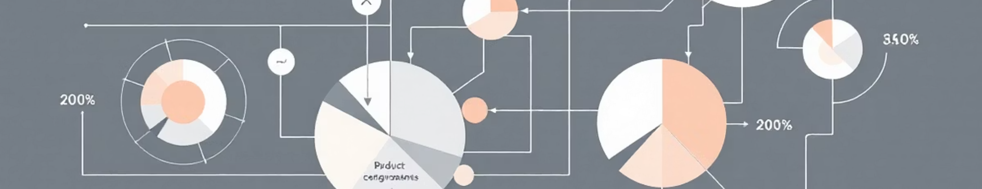
Project Overview & Goals
Analyze Behavior
Uncover Insights
Guide Decisions
3,900 purchases, various categories.
Spending patterns, segments, preferences.
Strategic business recommendations.

Slide 3
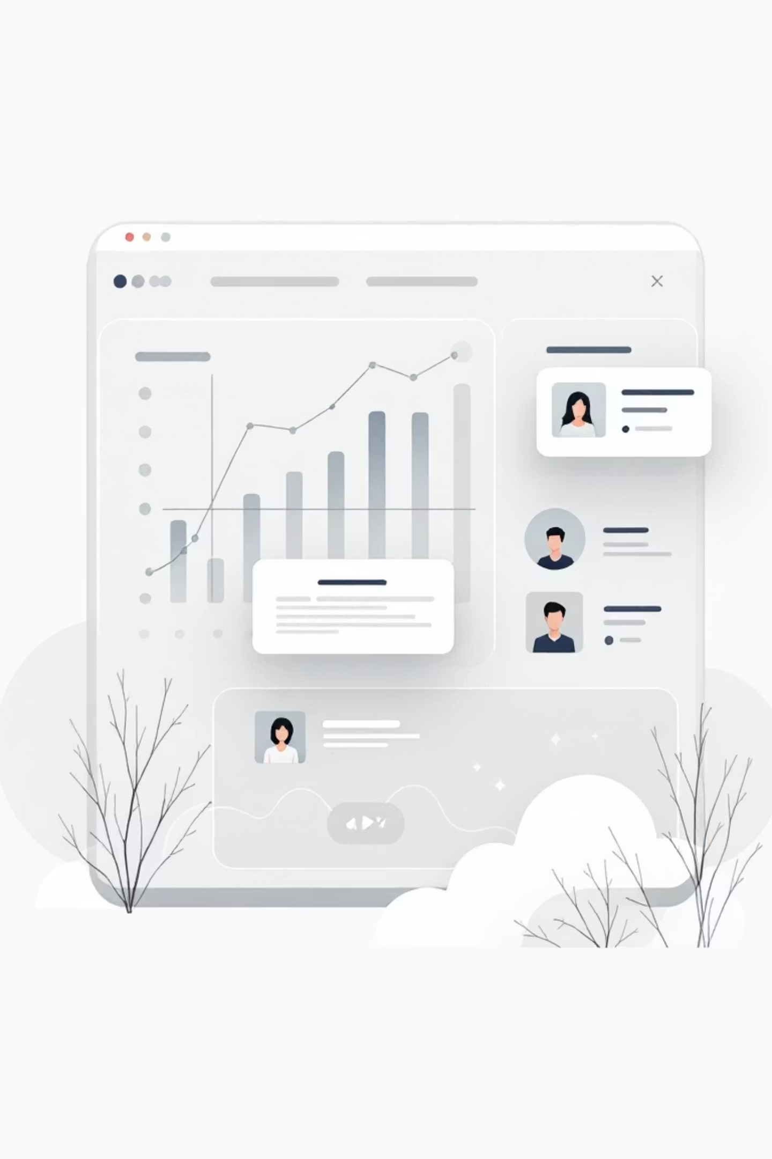
Dataset Summary
Key Features
Data Snapshot
Demographics (Age, Gender, Location)
3,900 Rows, 18 Columns
37 Missing Review Ratings
Purchase Details (Item, Category, Amount)
Behavior (Discount, Promo, Reviews)

Slide 4
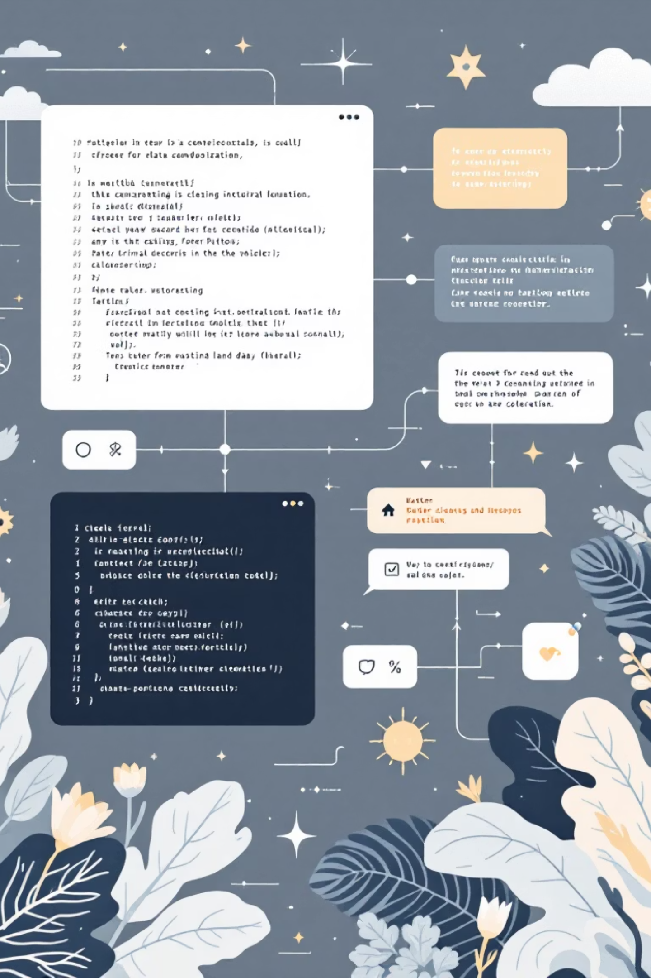
Exploratory Data Analysis (Python)
01
Data Loading & Exploration
Pandas for import, `df.info()`, `.describe()` for overview.
02
Missing Data Handling
Imputed Review Rating with median per category.
03
Feature Engineering
Created `age_group` and `purchase_frequency_days`.
04
Database Integration
Loaded cleaned data into PostgreSQL for SQL analysis.

Slide 5


SQL Analysis: Key Business Questions
Revenue by Gender
High-Spending Discount Users
Male: $157,890 vs. Female: $75,191
839 customers spent above average with discounts.
Top 5 Products by Rating
Gloves (3.86), Sandals (3.84), Boots (3.82).

Slide 6

SQL Analysis: Shipping & Subscriptions
1
2
Shipping Type Comparison
Subscribers vs. Non-Subscribers
Express: $60.48 avg. vs. Standard: $58.46 avg.
Subscribers: $59.49 avg. spend, $62,645 total revenue.
3
Repeat Buyers & Subscriptions
958 repeat buyers are subscribers.

Slide 7
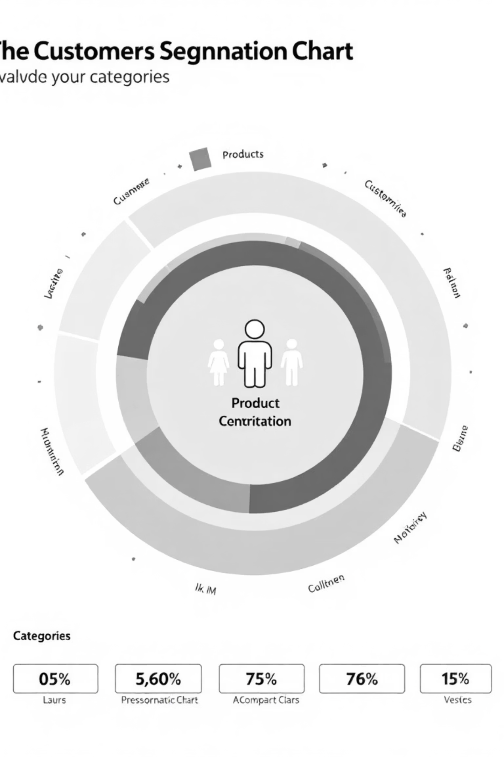



SQL Analysis: Product & Customer Focus
Discount-Dependent Products
Hat (50%), Sneakers (49.66%), Coat (49.07%).
Customer Segmentation
Loyal (3116), Returning (701), New (83).
Top 3 Products per Category
Jewelry, Blouse, Sandals, Jacket lead their categories.

Slide 8
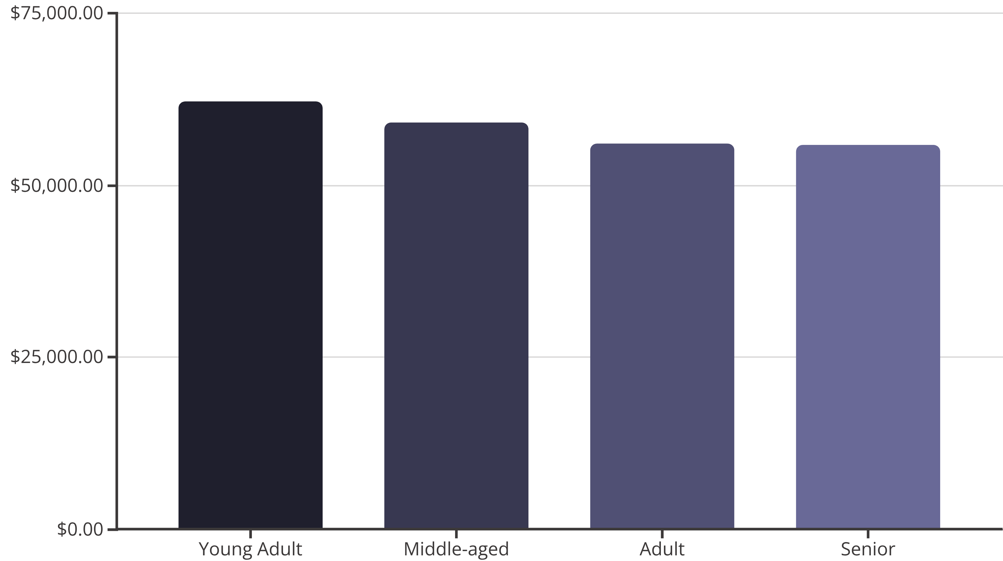
Revenue by Age Group
Young Adults contribute the highest revenue, followed closely by Middle-aged customers.

Slide 9
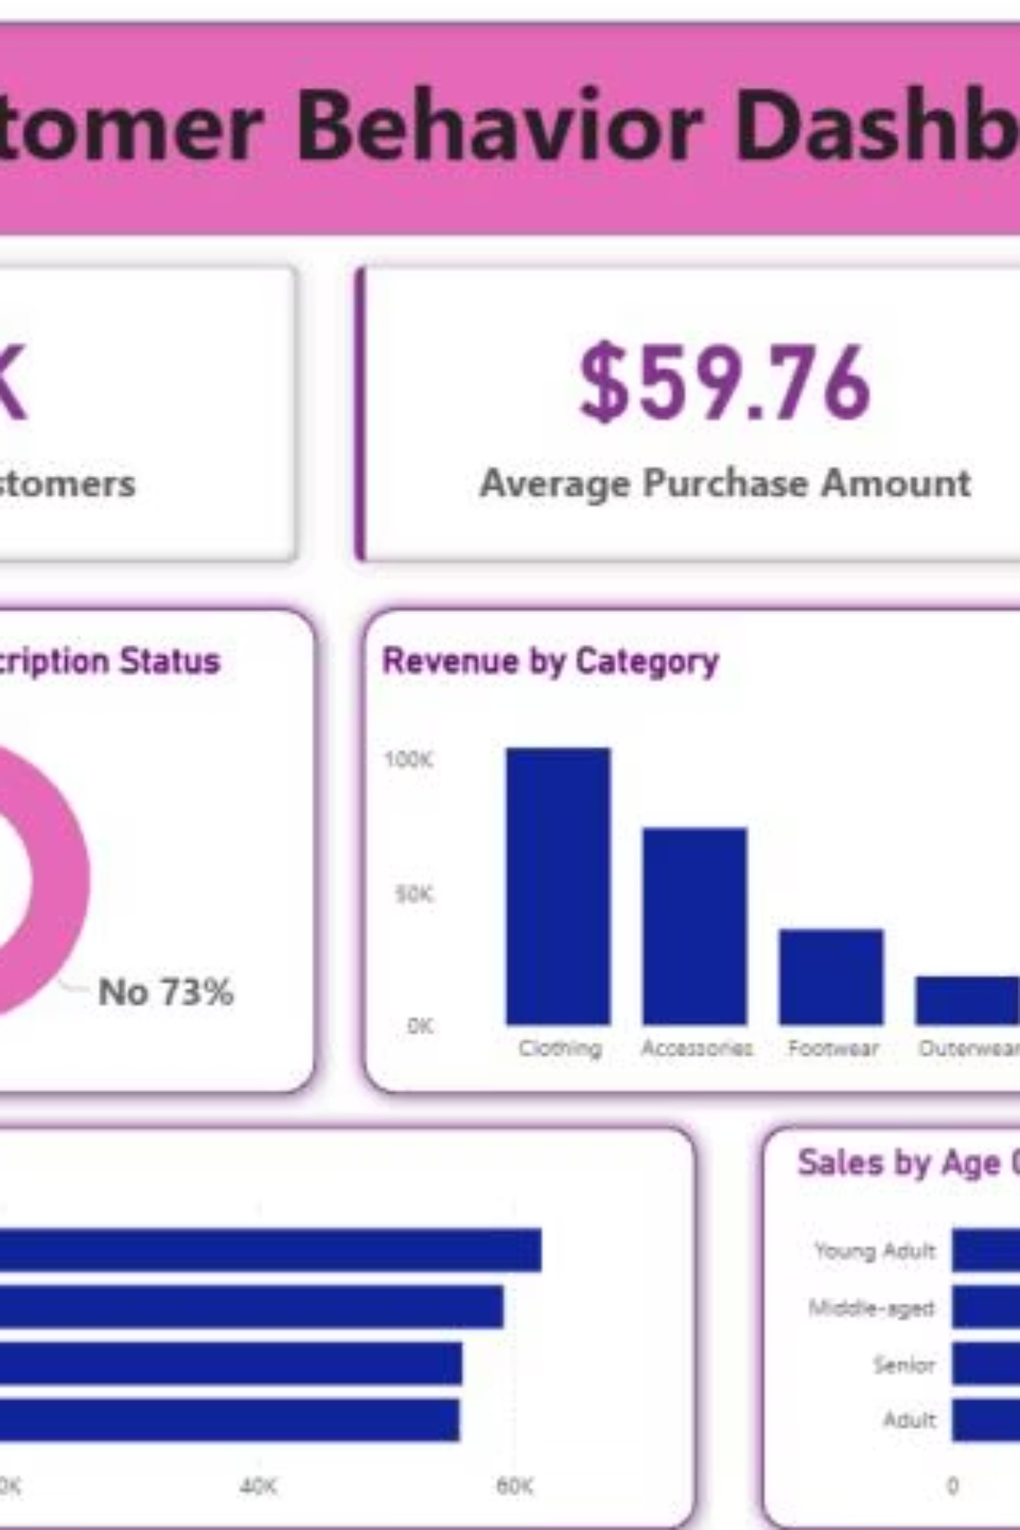
Interactive Dashboard in Power BI
Visualizing key insights for easy understanding and decision-making.
3.9K
$59.76
3.75
Customers
Avg. Purchase
Avg. Review

Slide 10

Business Recommendations
Boost Subscriptions
Promote exclusive benefits.
Customer Loyalty Programs
Reward repeat buyers.
Review Discount Policy
Balance sales with margin control.
Targeted Marketing
Focus on high-revenue groups.

